Slide 1
ANN
The Hopfield Network

Slide 2
The Hopfield Network
The Nobel prize winner John Hopfield has developed the discrete Hopfield net. The net is a fully interconnected neural net, in the sense that each unit is connected to every other unit. The discrete Hopfield net has symmetric weights with no self-connections, i.e,
Wij = Wji = And Wii = 0
In this NN, inputs of 0 or 1 are usually used, but the weights are initially calculated after converting the inputs to -1 or +1 respectively.

Slide 3
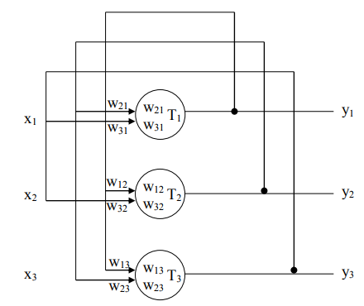
The Hopfield network

Slide 4
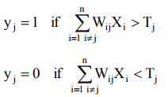
The outputs of the Hopfield are connected to the inputs as shown in Figure, thus feedback has been introduced into the network. The present output pattern is no longer dependent on the present inputs, but is also dependent on the previous outputs. Therefore, the network can be said to have some sort of memory, also the Hopfield network has only one layer of neurons. The response of an individual neuron in the network is given by: -

Slide 5
This means that for the jth neuron, the inputs from all other neurons are weighted and summed. Note i ≠ j , which means that the output of each neuron is connected to the input of every other neuron, but not to itself. The output is a hard-limiter which gives a 1 output if the weighted sum is greater than Tj and an output of 0 if the weighted sum is less than Tj. it will be assumed that the output does not change when the weighted sum is equal to Tj.
Thresholds also need to be calculated.
This could be included in the matrix by assuming that there is an additional neuron, called neuron 0, which is permanently stuck at 1.
All other neurons have input connections to this neuron’s output with weight W01, W02, W03,…etc. this provides an offset which is added to the weighted sum. The relationship between the offset and the threshold Tj is therefore:- Tj = -W0j
The output [y] is just the output of neuron 0 which is permanently stuck at 1, so the formula becomes:- [ W0] =[X]^{t} [Y0].

Slide 6
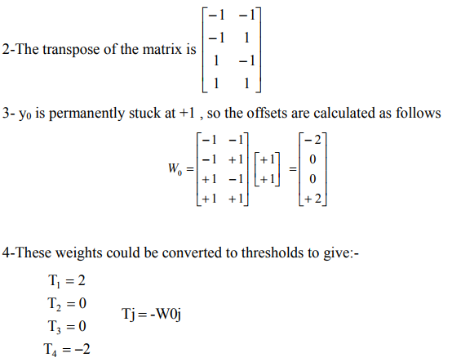
Ex-6 if the patterns X1= [0011] and X2= [0101] are to be stored, first convert them to
X1= [ -1 -1 1 1] and X2= [ -1 1 -1 1]. To find the threshold:
1- The matrix $\left[\begin{matrix}−1 −1 1 1 \\ −1 1 −1 1\end{matrix}\right]$

Slide 7
EX-7 consider the following samples are stored in a net: -
M0=[0 1 0 0], M1=[1 1 0 0], M2=[0 0 1 1]
binary convert to bipolar
The binary input is (1110). We want the net to know which of samples is the i/p near to?
Note: - A binary Hopfield net can be used to determine whether an input vector is a “known” vector (i.e., one that was stored in the net) or “unknown” vector.

Slide 8
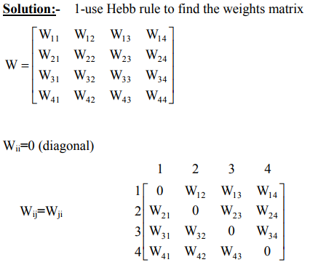
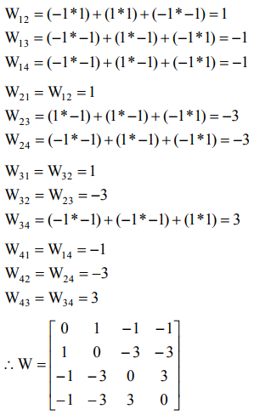

Slide 9
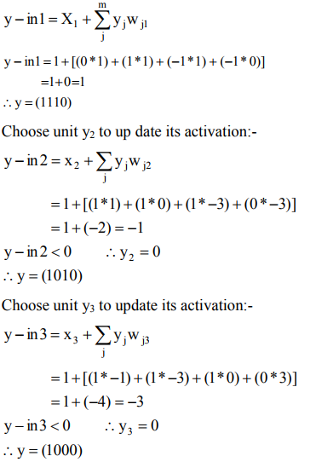
2-The i/p vector x = (1 1 1 0). For this vector, y= (1 1 1 0) Choose unit y1 to update its activation

Slide 10
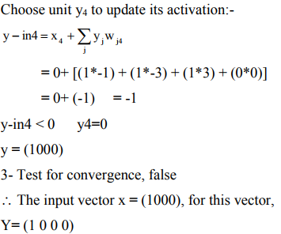

Slide 11
